Slide 1

SDC HACKATHON 2026
• PHASE 1: PRELIMINARY PROJECT PROPOSAL
LumiPath
Future-Ready Workforce Navigator
Host
Submission Deadline
Xiamen University Malaysia (XMUM) AI Club
25 October 2026

Slide 2
1. Team & Project Overview
Key project metadata & university affiliation
Team Name | White Cloud
Selected Domain & SDG Track | Domain 1 (SDG 4 and SDG 8)
Project / Solution Name | LumiPath
Team Leader & Affiliation | Elson Lim Zhong Qin (Xiamen University Malaysia)
Number of Team Members | 3

Slide 3
2. Executive Summary & Problem Statement
2.1 The Problem Context
Rapid advancements in Artificial Intelligence (AI) and Industry 4.0 automation reduce labor demand in routine technical roles, causing workforce displacement across industrial sectors in Malaysia. According to the WEF Future of Jobs Report 2025, automation poses a 28.5% substitution risk to more than 2,800 granular skills. Displaced workers face skill depreciation, wage stagnation, and a severe lack of transparent upskilling pathways. Our project provides structured, data-backed career transition pathways for workers adapting to shifting industrial demands.

Slide 4
2. Executive Summary & Problem Statement
2.2 The Proposed AI Solution — Platform Concept & Matching Engine
We introduce LumiPath under the slogan “We will light the path to your future” to navigate career transitions and skill upgrades. LumiPath extracts unstructured resumes into standardized worker profiles. It integrates O*NET 28.1 data to assess emerging and declining skills, and executes deterministic mathematical matching (0.7 skill overlap + 0.3 tenure weight) to rank suitable target positions.

Slide 5
2. Executive Summary & Problem Statement
2.2 The Proposed AI Solution — Learning Pathways & Automation Modeling
The platform generates a 3-stage learning pathway comprising foundational gap-filling, advanced skill acquisition, and statutory certifications linked to HRD Corp courses. LumiPath models transition risks across two scenarios: steady evolution (3–5 years) and rapid disruption (1–2 years), indicating automation timelines to guide worker decisions. Technically, LumiPath connects Google Gemini 2.5 Flash API, RunPod Serverless containers, and a lightweight Flask architecture hosted on Replit.

Slide 6
3. Technical Architecture & Implementation Plan
3.1 Conceptual Tech Stack — Presentation & Calculation Layers
Presentation Layer:
Single-page web interface built with HTML5, CSS3, and JavaScript, served by Python Flask.
Core Calculation Layer:
Developed on Python 3.11, featuring RoleMatcherService (0.7 skill overlap + 0.3 tenure weight) and PathwayPlannerService (automated 3-stage course retrieval).

Slide 7
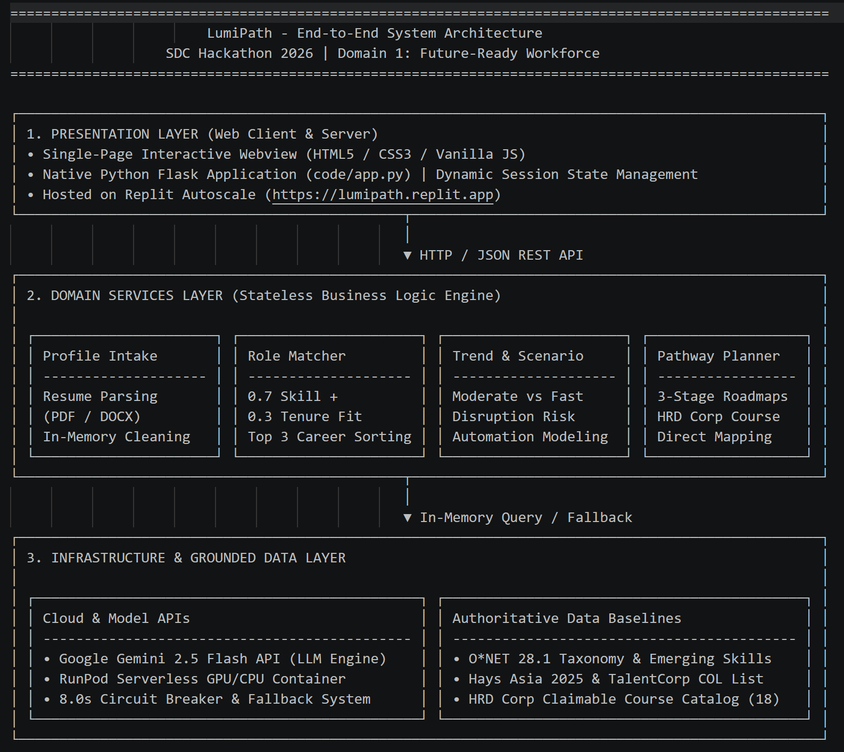
3. Technical Architecture & Implementation Plan
3.1 Conceptual Tech Stack — AI, Data Baselines & Sponsor Usage
AI & Reliability:
Google Gemini 2.5 Flash API with an 8.0-second network timeout circuit breaker and local snapshot fallback.
Authoritative Data Baselines:
Anchored in the US Department of Labor O*NET 28.1, Malaysia TalentCorp Critical Occupations List (COL), NIOSH Malaysia statutory syllabus, and UN A/RES/70/1.
Official SDC Sponsor Usage:
RunPod Serverless GPU/CPU container endpoints for batch inference; Replit Autoscale for 24/7 online prototype hosting.

Slide 8
3. Technical Architecture & Implementation Plan
3.2 Design-Thinking & Deployment Strategy
LumiPath implements an editable human-in-the-loop workflow: users review and freely modify extracted profile fields and skill tags prior to computation. To address automation uncertainty, the interface visualizes dual disruption timelines (steady evolution vs rapid disruption), giving workers transparent time horizons. The prototype deploys on a native HTML/CSS/JS frontend served by Flask to eliminate multi-step navigation. Backend batch inference executes via RunPod Serverless containers, scaling dynamically under demand and idling at zero cost.

Slide 9
Demo

Slide 10
4. Environmental & SDG Impact Framework
Target SDG Sub-Targets & Current Problem Baseline
Target SDG Sub-Target(s):
Target 4.4: “Increase the number of youth and adults that have relevant skills for employment, entrepreneurship and decent jobs.”
Target 8.2: “Achieve higher levels of economic productivity through diversification, technological upgrading and innovation.”
Current Problem Baseline:
28% of the more than 2,800 granular skills face moderate capacity of replacement. According to Labour Market Review, Second Quarter 2026 by DOSM, the skill-related underemployment rate stood at 35.2%.

Slide 11
4. Environmental & SDG Impact Framework
Core Measurable KPIs & Phase 2 Impact Target
Core Measurable KPI:
• Alignment rate of reshaped roles with National Critical Occupations List (COL): 100%
• Target role skill gap resolution coverage: 100%
• Employer training levy claimability coverage (HRD Corp Claimable) for advanced certifications: 100% by Phase 3
Phase 2 Impact Target:
Scale to 5+ industrial fields by final prototype presentation.

Slide 12
Thank You

